Slide 1
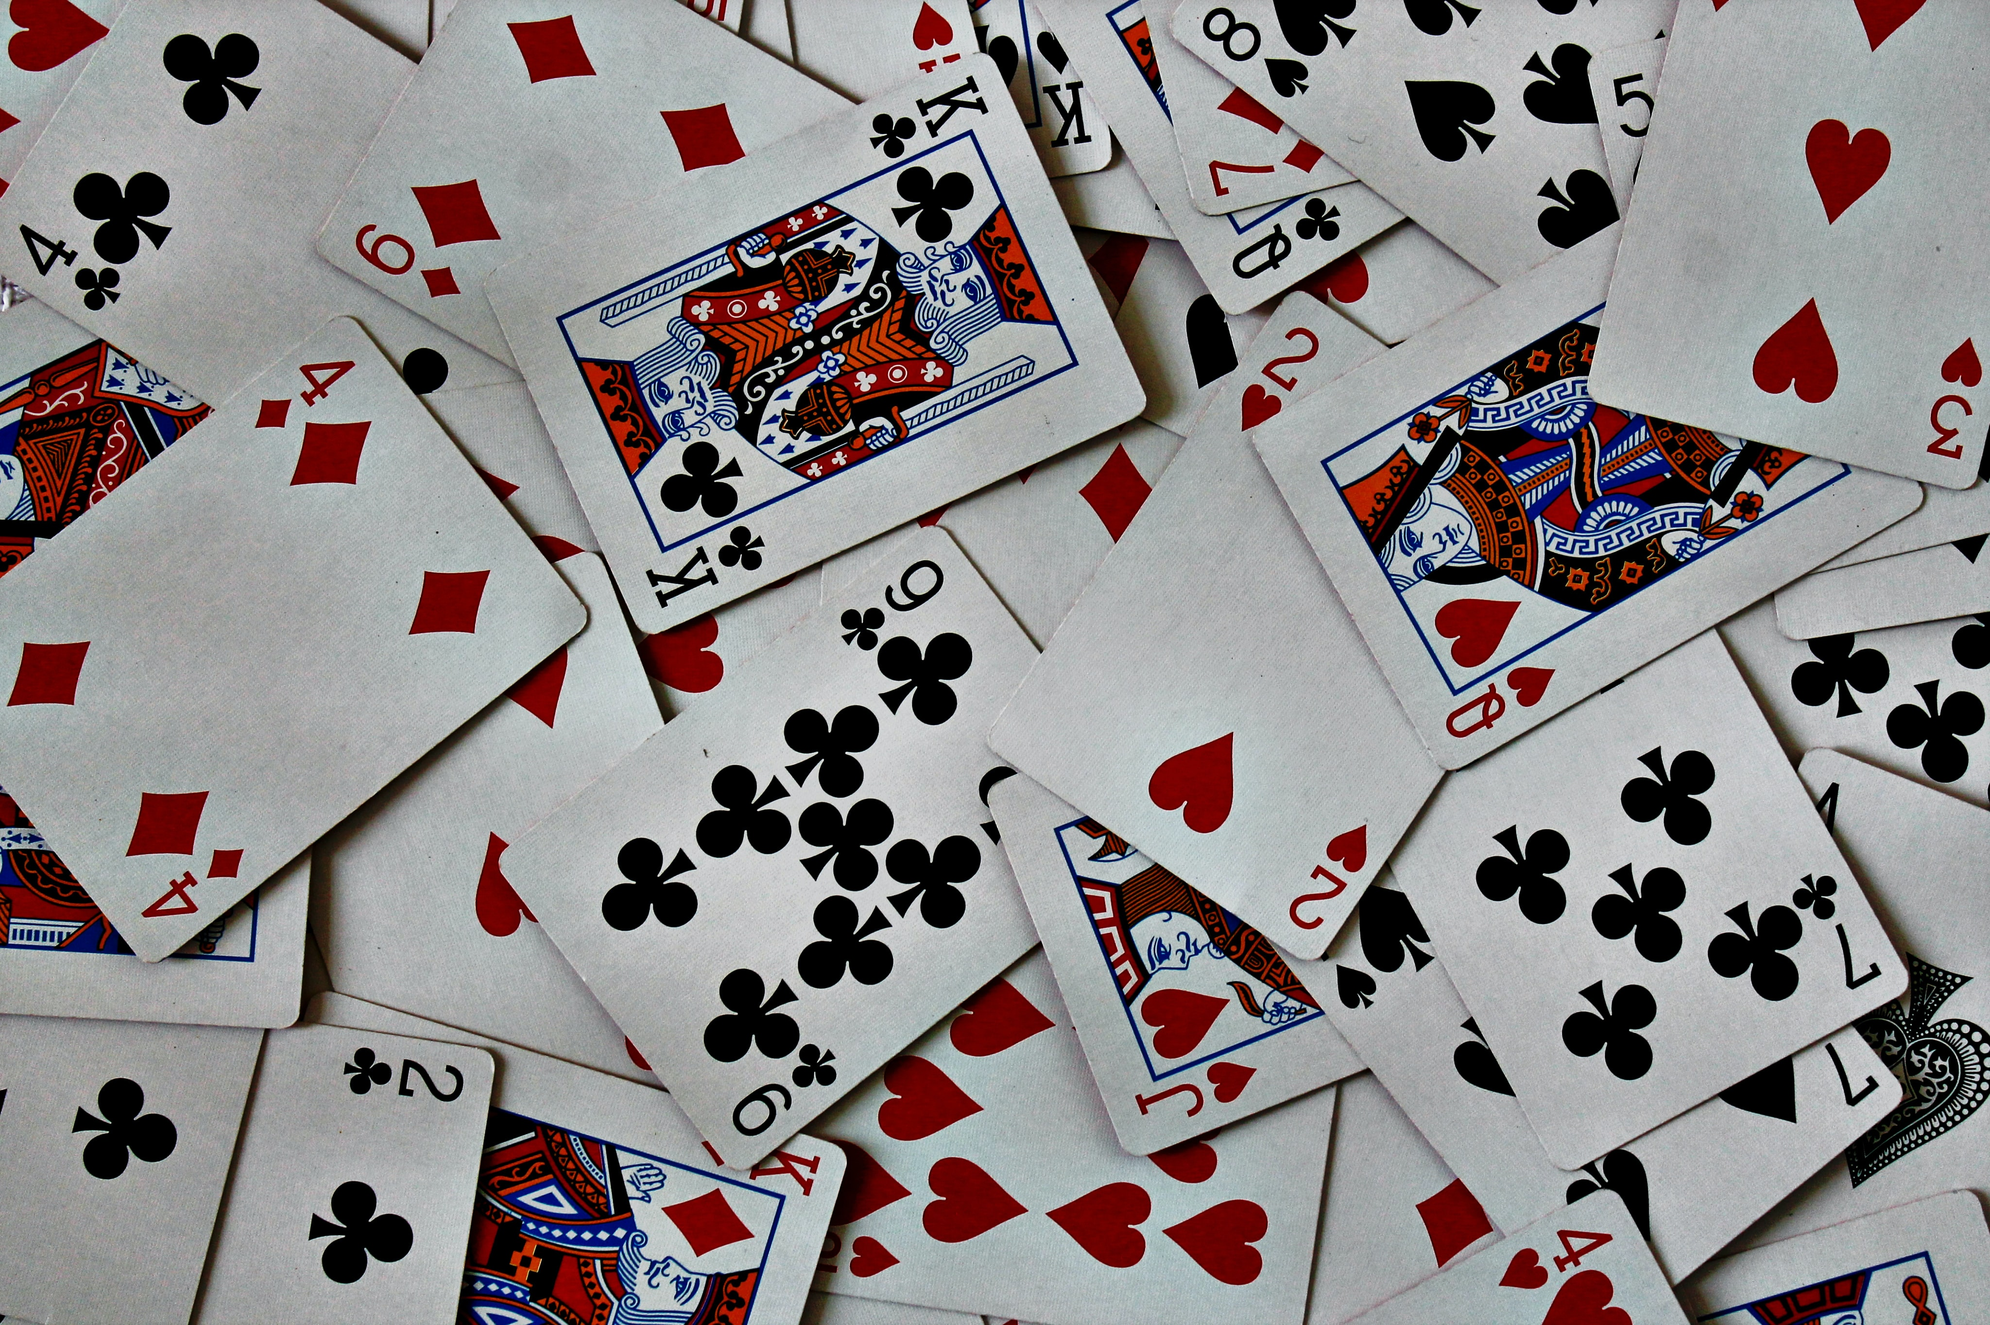
A Survey of Monte Carlo Tree Search Methods

Slide 2
Outline
Introduction
Basics via Tic-Tac-Toe
Variations
Use Case
Conclusion

Slide 3
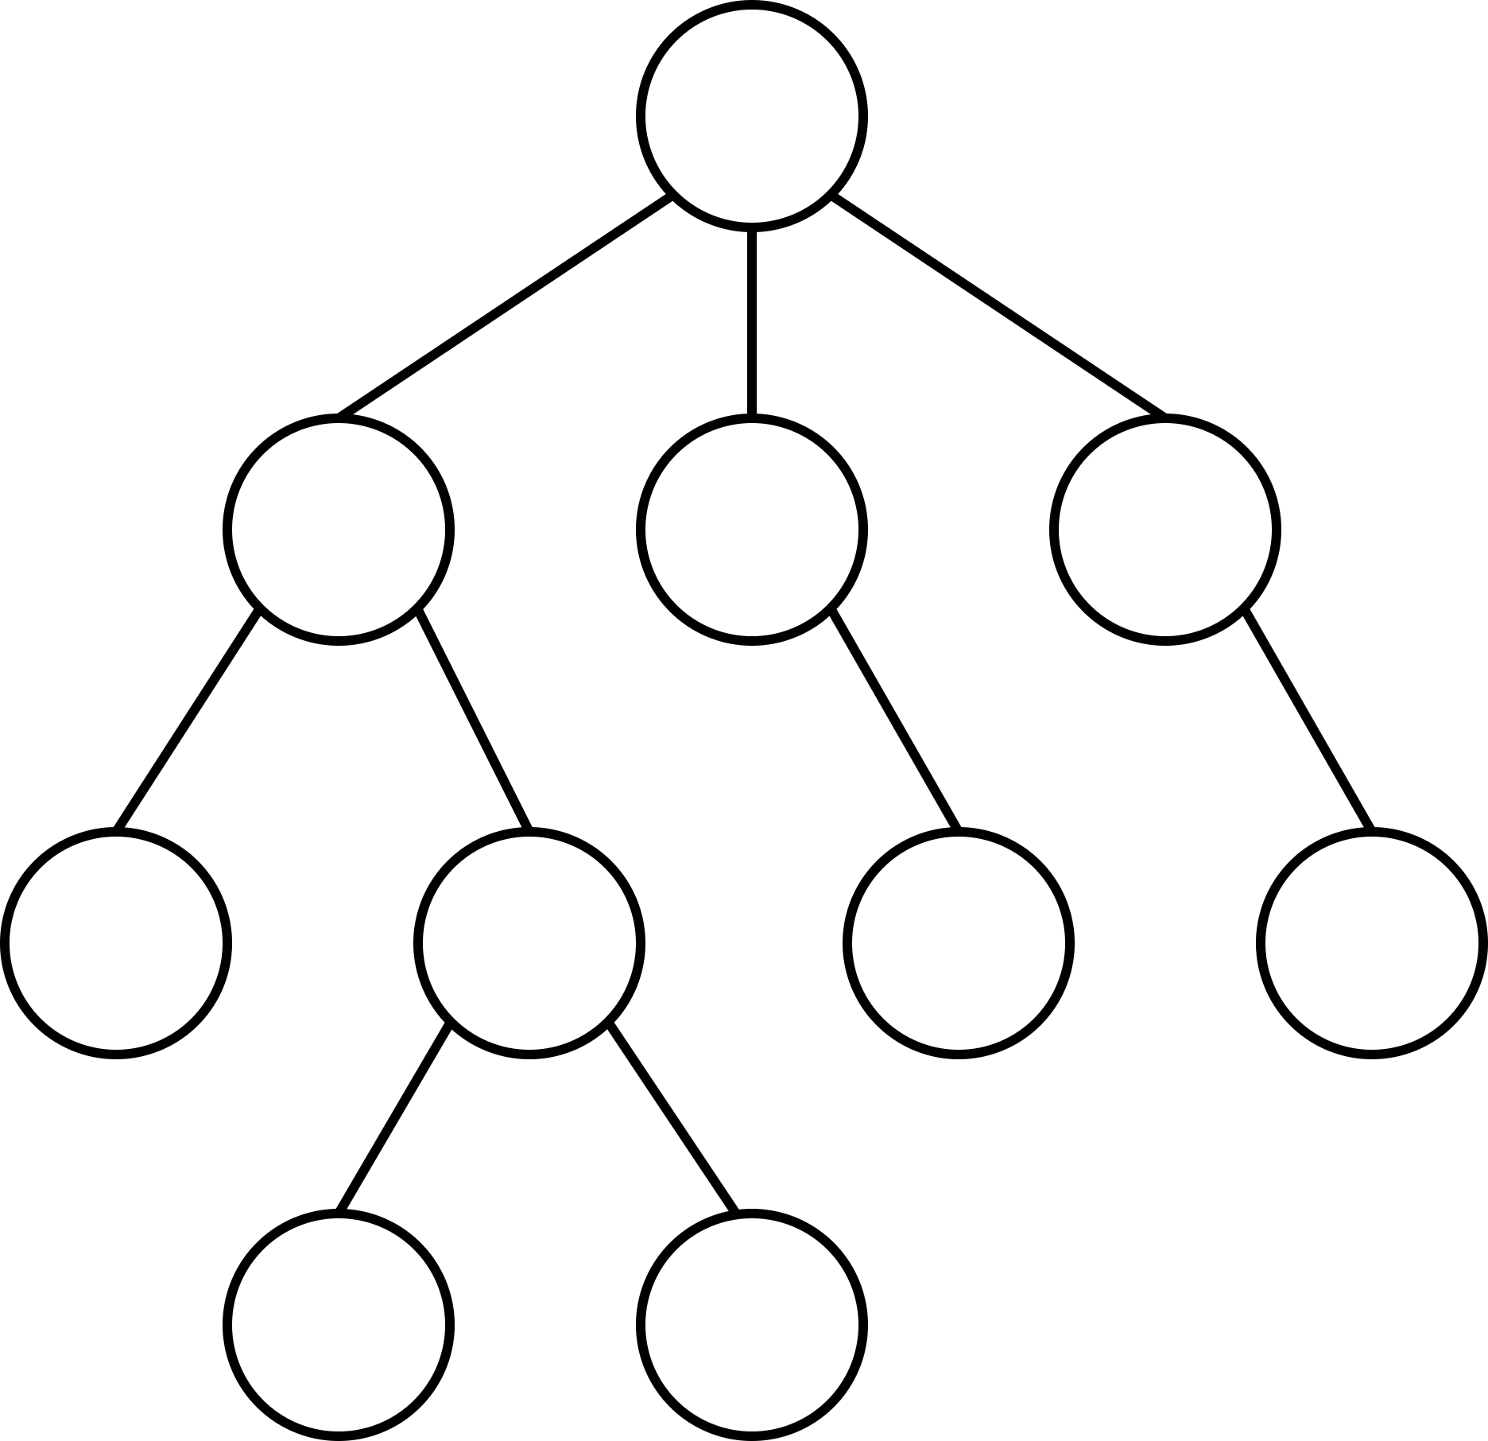
Introduction
Consider a game-playing agent
How to find good/best next move?
Game represented as a game tree
Nodes represent (subset of) states
Still too large to check all actions
MCTS-Idea: Combine sampling and tentative rewards
refine “view” of the current game tree iteratively
Don’t overthink the term “game”
Generally applicable search algorithm
state of game
(legal) action

Slide 4
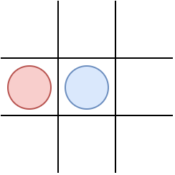
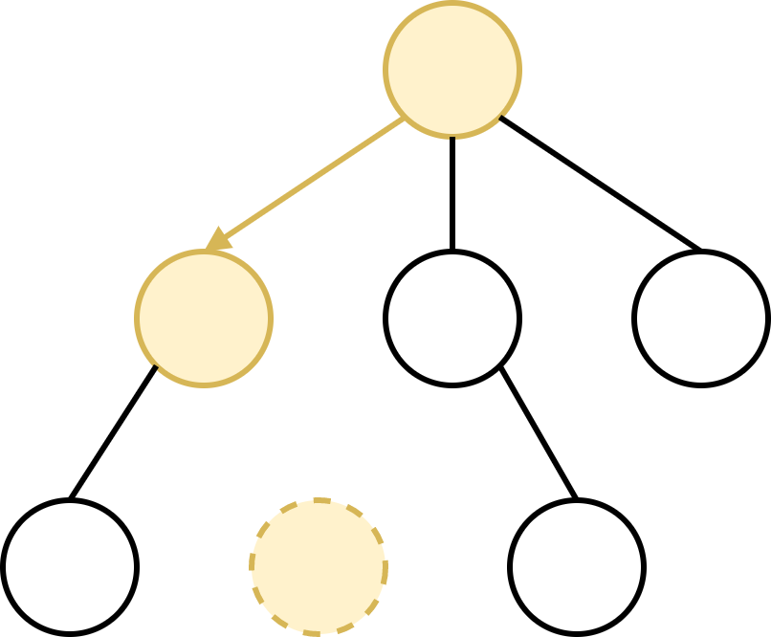
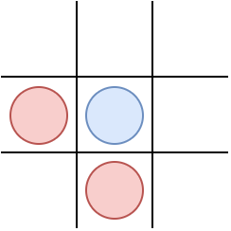
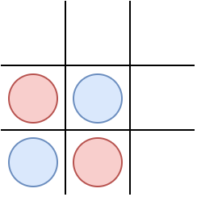
MCTS in Tic-Tac-Toe
Step 1 – Selection

Slide 5
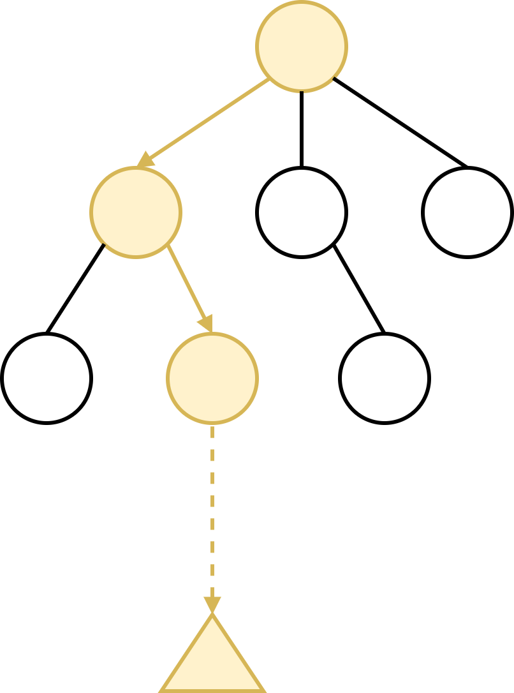
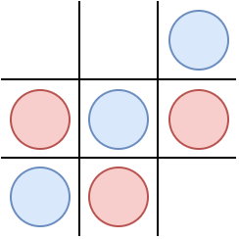
MCTS in Tic-Tac-Toe
Step 2 – Expansion
Step 3 – Simulation

Slide 6
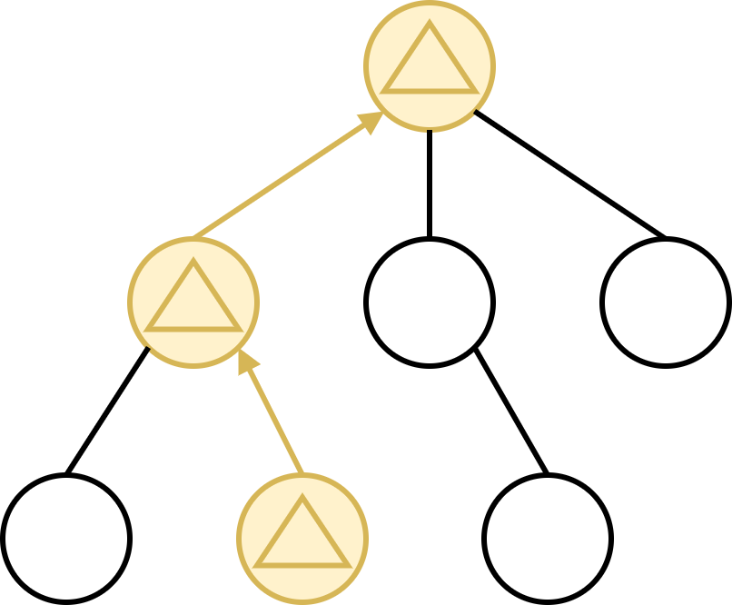
MCTS in Tic-Tac-Toe
Step 4 – Backpropagation
… on to the next iteration

Slide 7
MCTS - Variations
Tic-Tac-Toe:
shallow game tree: short paths
narrow game tree: few paths
meaningful states: actually different game states
Need to generalize:
Selection Policy
UCT [1]
AMAF and (G)RAVE [2,3,4]
State Evaluation
Loss Avoidance [5]
Novelty-based Pruning [5]
Knowledge-Based Evaluations [5]
many simulations
useful results
[1] Kocsis and Szepesvári:
Bandit based Monte Carlo Planning,
2006
[2] Gelly and Silver:
Combining online and offline knowledge in UCT, 2007
[3] Gelly and Silver:
Monte-Carlo tree search and rapid action evaluation in computer Go,
2011
[4] Cazenave:
Generalized Rapid Action Evaluation,
2015
[5] Soemers et al.:
Enhancements for Real-Time Monte-Carlo Tree Search in General Video Game Playing,
2016

Slide 8
UCT
Selection Policy
“Upper Confidence Bound for Trees”
s(v) – state s represented by node v
a(v) – incoming action a of node v
Q(v) – total simulation reward of v
N(v) – number of times v has been visited
Add. data structures possible
e.g. N(a)
v
s(v)
a(v)
Q(v)
N(v)
v
a₀
a₁
a₂
v‘
v‘‘
v⁽³⁾

Slide 9
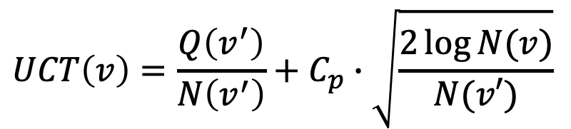
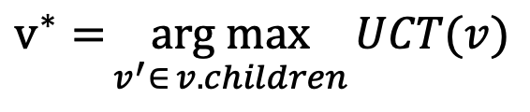
UCT
Selection Policy
Child node selection:
Transfer: Multi-Armed-Bandits
$$v^{∗}={\underset{v^{′}∈ v.children}{arg max}{UCT(v)}}$$
Exploitation – follow paths deemed valuable
Exploration – discover new paths
$$UCT\left(v\right)=\frac{Q\left(v^{′}\right)}{N\left(v^{′}\right)}+C_{p}∙\sqrt{\frac{2\log{N(v)}}{N(v′)}}$$

Slide 10
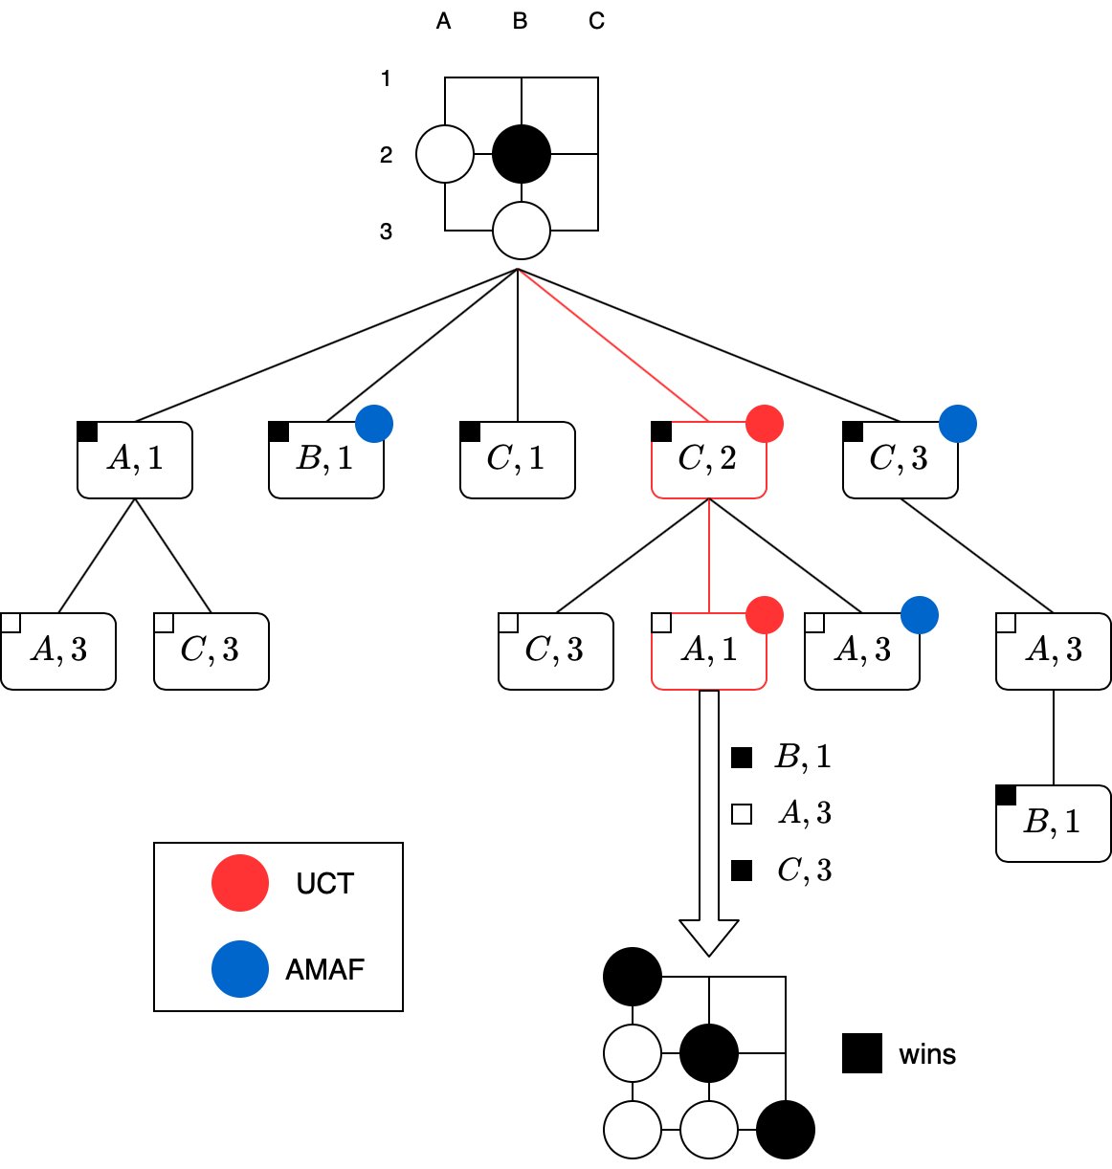
AMAF
Selection Policy
“all moves as first”
Update more nodes per simulation
possible and actual choices
New value: AMAF-score

Slide 11
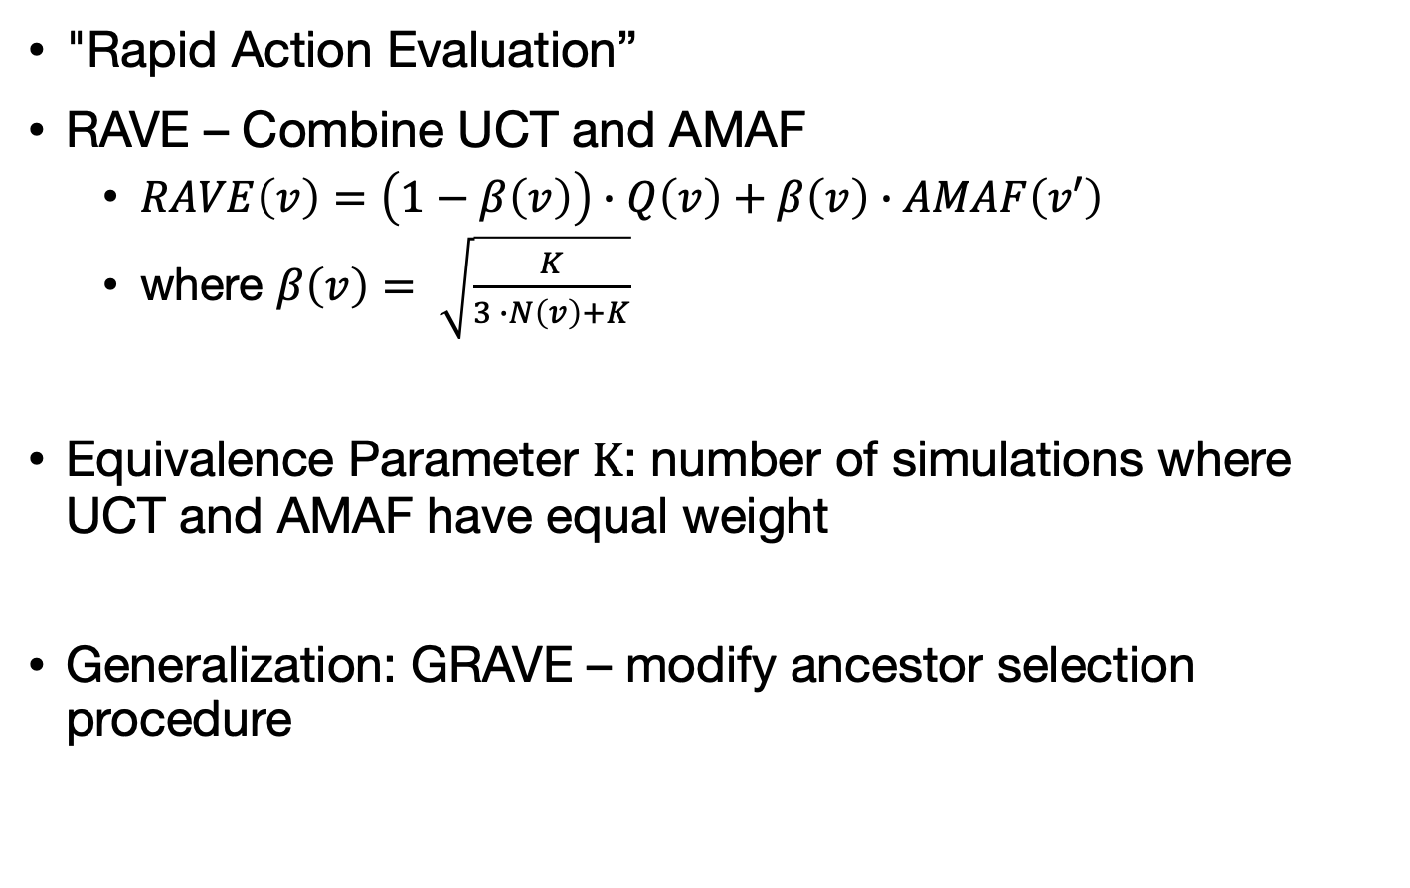
AMAF
Selection Policy
"Rapid Action Evaluation”
RAVE – Combine UCT and AMAF
$RAVE\left(v\right)=\left(1−β\left(v\right)\right)∙Q\left(v\right)+β\left(v\right)∙AMAF\left(v′\right)$
where $β\left(v\right)= \sqrt{\frac{K}{3 ∙N\left(v\right)+K}}$
Equivalence Parameter K: number of simulations where UCT and AMAF have equal weight
Generalization: GRAVE – modify ancestor selection procedure
ancestor of v: which one?

Slide 12
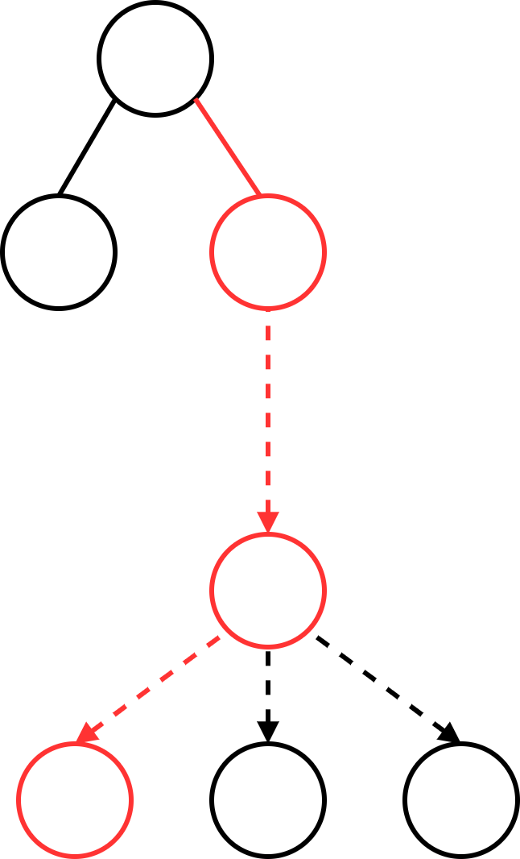
Loss Avoidance
State Evaluation
Ignore negative results when encountering new nodes
If unvisited node represents a loss, generate neighbors
Backpropagate only best-case scenario
Similar (inverse) approach for overly optimistic evaluations
result of simulation
generated states

Slide 13
Novelty-based Pruning
State Evaluation
Problem: Many similar states and redundant paths
Solution: Use a novelty measure nov(v), all nodes above a threshold are pruned
Step 1: For node v, define a neighborhood of other nodes
Step 2: Compare nodes in the neighborhood to v, giving us their similarity or novelty
Step 3: Prune v if it is too similar to any other nodes

Slide 14
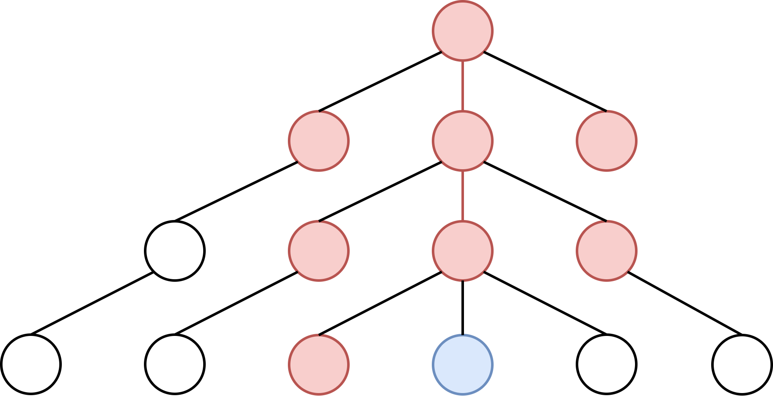
Novelty-based Pruning
State Evaluation
Step 1: the neighboorhood N(v) is the union of
the left siblings of v
the parent of v: p(v)
all siblings of p(v)
the neighborhood of p(v)
v
p(v)

Slide 15
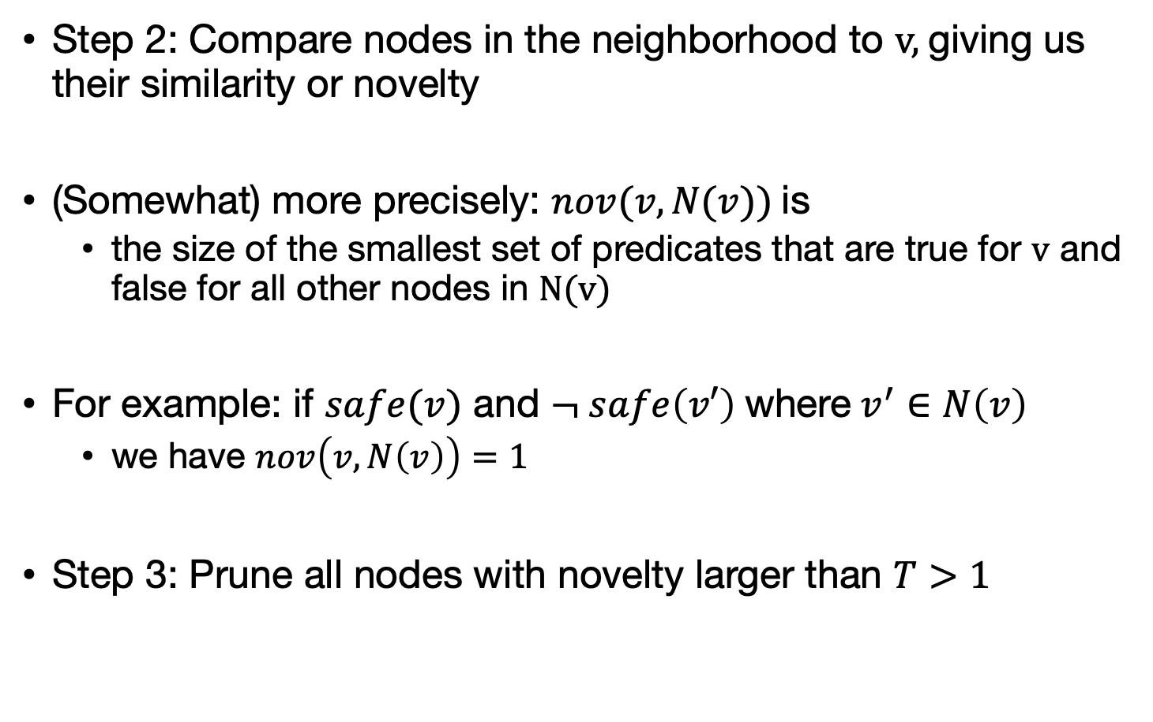
Novelty-based Pruning
State Evaluation
Step 2: Compare nodes in the neighborhood to v, giving us their similarity or novelty
(Somewhat) more precisely: $nov(v,N(v))$is
the size of the smallest set of predicates that are true for v and false for all other nodes in N(v)
For example: if $safe(v)$ and $¬ safe\left(v′\right)$ where $v^{′}∈N\left(v\right)$
we have $nov\left(v,N\left(v\right)\right)=1$
Step 3: Prune all nodes with novelty larger than $T>1$

Slide 16
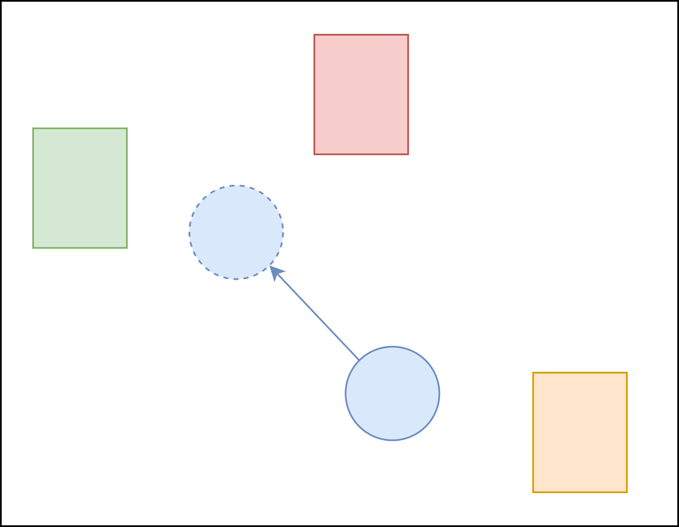
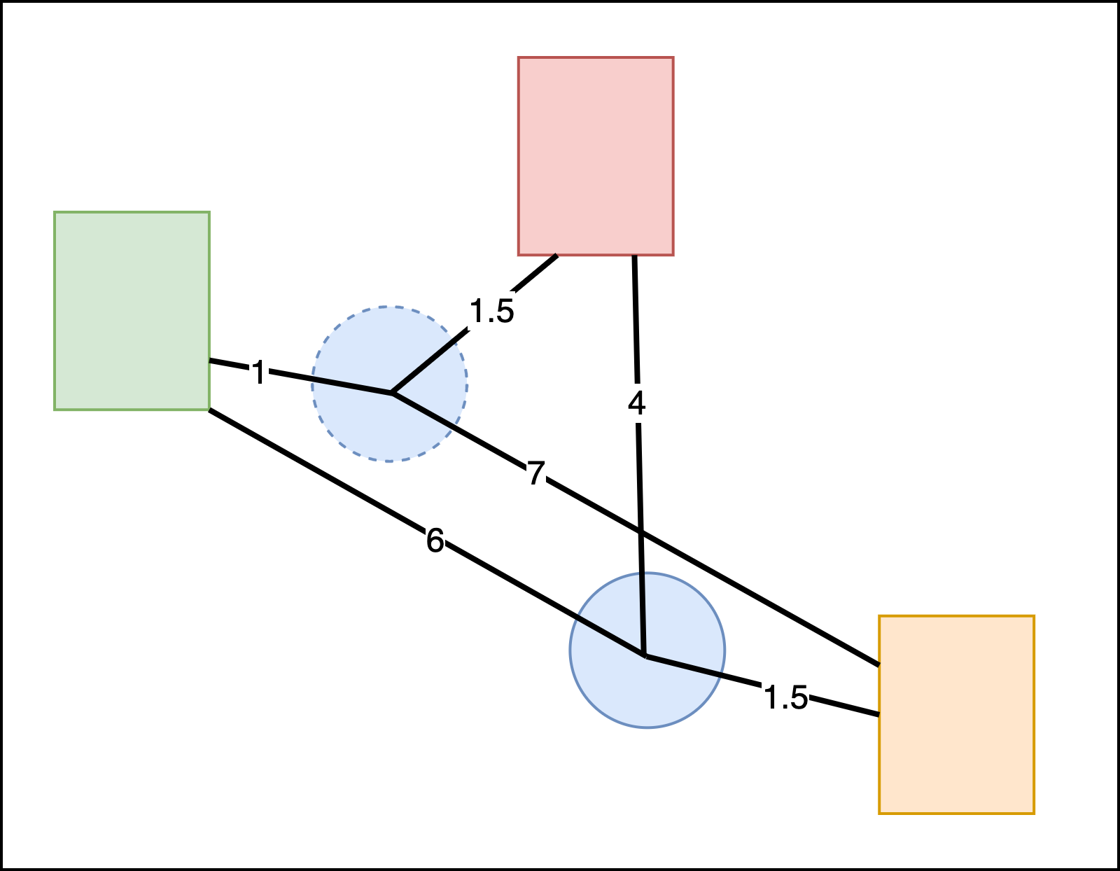
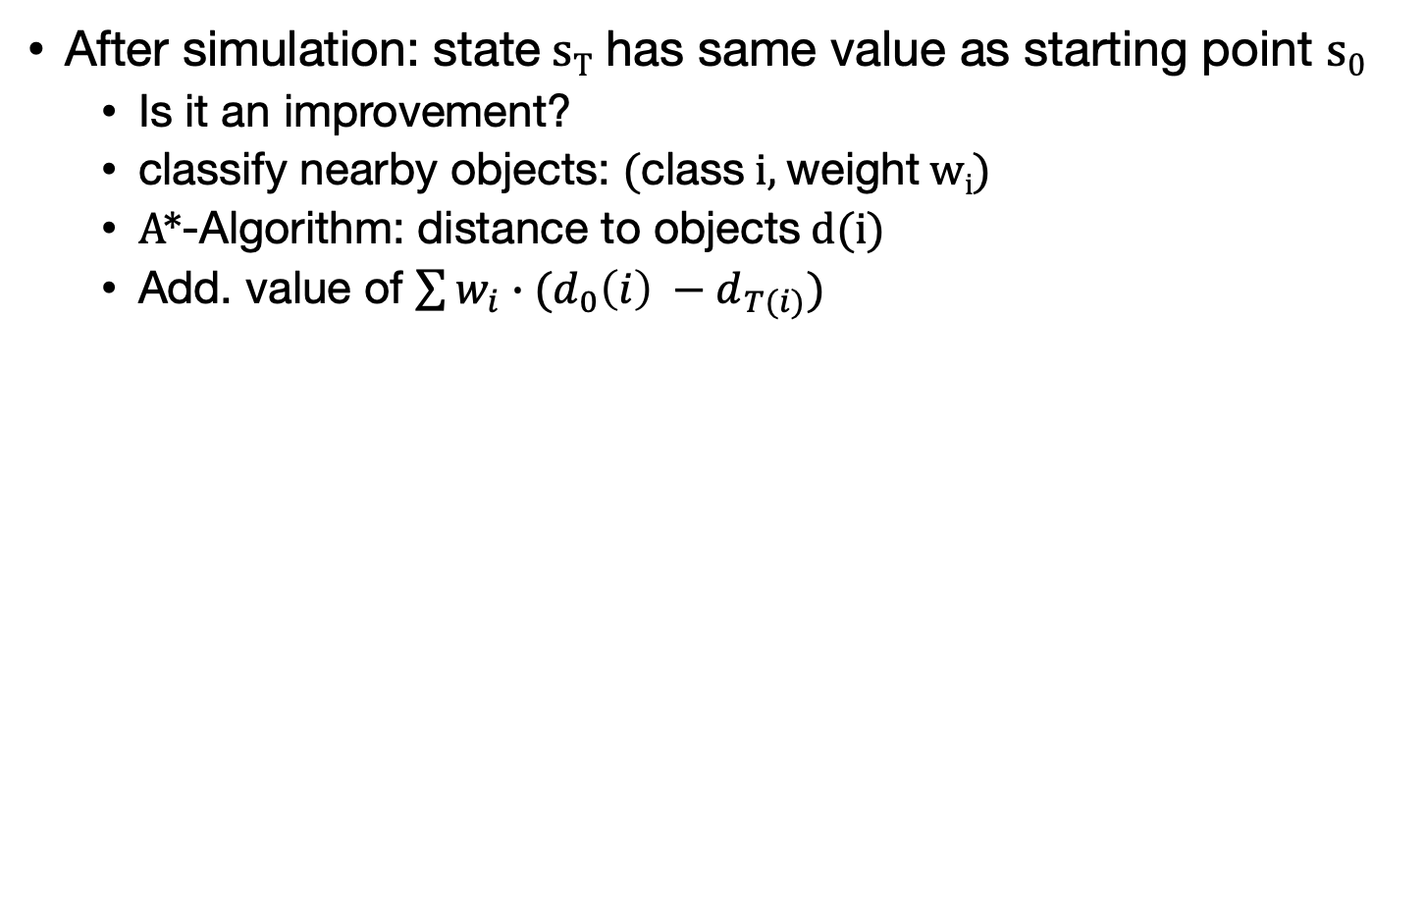
Knowledge-based Evaluations
State Evaluation
After simulation: state s_{T} has same value as starting point s₀
Is it an improvement?
classify nearby objects: (class i, weight w_{i})
A*-Algorithm: distance to objects d(i)
Add. value of $\sum{w_{i}}∙(d_{0}\left(i\right) −d_{T(i)})$
(A,0.8)
(B,0.2)
(B,0.5)

Slide 17
Use Case: AlphaGo
Source: https://cdn.vox-cdn.com/thumbor/nQ5aqmJ_DA5-Dsm82McDmyHr2dM=/0x84:1600x984/1600x900/cdn.vox-cdn.com/uploads/chorus_image/image/49054581/akrales_160307_0970_a_0127.0.0.0.png, (30.07.2020)

Slide 18
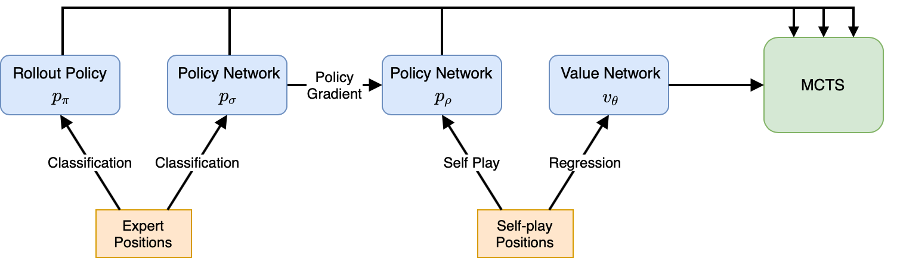
Use Case: AlphaGo
ML-System that beat some of the world’s greatest players in the game of Go (2016)
MCTS used in combination with neural networks
Simulation combines policy networks and value networks

Slide 19
Conclusion
MCTS – Search algorithm that combines
sampling
and simulations
Addresses Exploration-Exploitation tradeoff
Works well out of the box but can be extended and tailored to specifics of current domain
Heuristics
Transfer techniques from statistics and probability theory
Most famous application: games
AlphaGo

